Slide 1

MICRO CREDIT DEFAULTER PROJECT
-Siddhant Sethi

Slide 2
Problem Statement
The problem relates to the field of telecom industry whereby a company is trying to leverage the upcoming unconventional type of banking in the form of Micro-finance institution. The company seeks to implement a business model in which it can help the poor and needy to continue with its services by providing them a loan of 5 or 10(Indonesian rupiah). The condition is that the customer ought to return the amount (loan + charges) within 5 days to avoid the default. Keeping this in mind, we are required to analyse and build a model to make predictions using the dataset provided.

Slide 3
Steps to be followed
Getting the dataset in csv format and important libraries imported to jupyter interface
Trying to know basic info. Regarding the dataset
Data pre-processing/EDA
Visualizations
Get the ‘model-fed’ ready data
Balancing the dataset before making split
Choosing the algorithms to be used
Getting the best performing one and to proceed with its hypertuning
Obtain results in the form of accuracy, cross-validation, classification report, confusion matrix, roc_auc curve
Finally, save the model using joblib in ‘.obj’ format

Slide 4
Step 1
All the libraries used are
import numpy as np
import pandas as pd
import matplotlib.pyplot as plt
import seaborn as sns
import warnings
warnings.filterwarnings('ignore')
pd.set_option('display.max_rows', None)
pd.set_option('display.max_columns', None)
import statistics
from sklearn.preprocessing import LabelEncoder
from scipy.stats import zscore
from sklearn.preprocessing import StandardScaler
from sklearn.model_selection import train_test_split

Slide 5
from sklearn.neighbors import KNeighborsClassifier
from sklearn.metrics import accuracy_score,confusion_matrix,classification_report
from sklearn.ensemble import GradientBoostingClassifier
from sklearn.svm import SVC
from sklearn.ensemble import RandomForestClassifier
from sklearn.ensemble import AdaBoostClassifier
from sklearn.linear_model import LogisticRegression
from sklearn.tree import DecisionTreeClassifier
from sklearn.naive_bayes import GaussianNB
import joblib as jb
from imblearn.over_sampling import SMOTE
from sklearn.model_selection import RandomizedSearchCV
from sklearn.metrics import roc_auc_score
from sklearn.metrics import roc_curve,auc
from sklearn.model_selection import cross_val_score
The csv file is as follows
df=pd.read_csv('micro_credit.csv')

Slide 6
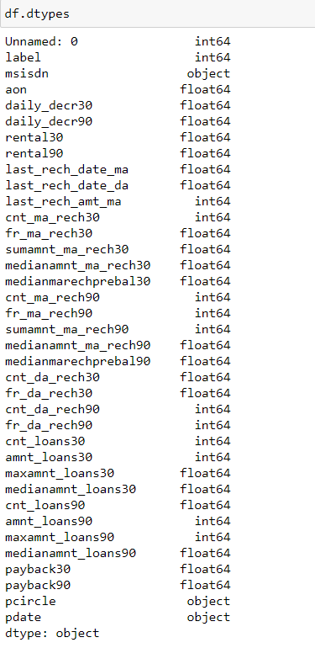
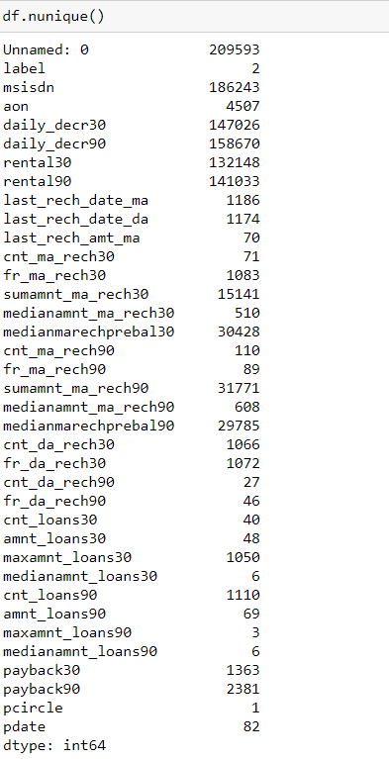

Step 2
Basic info

Slide 7
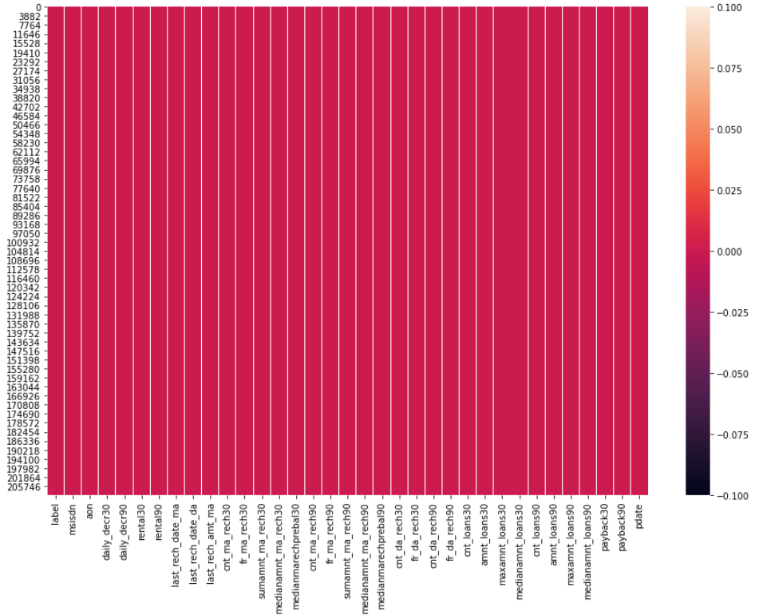

Step 3
Data pre-processing
Dropping no purpose columns
No missing value
Converting the feature 'pdate' into workable numeric values

Slide 8
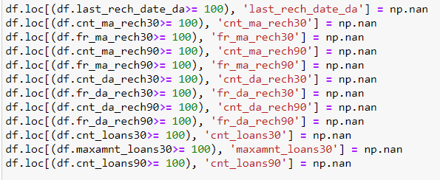
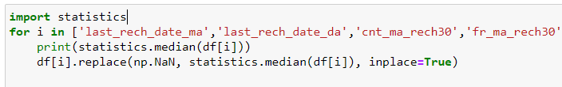
Treating unrealistic values
After observing carefully, we can see that certain features have real values only in double digits. Thus, we can set up a threshold of 100 to replace any unreal value with np.nan
Also, column ‘aon’ with negative value does noy make sense. Thus these can be dropped
Now we need to replace nan values with respective medians
e.g.

Slide 9

Label encoding
Need to convert phone no. to numeric type as many numbers are repeating themselves

Slide 10
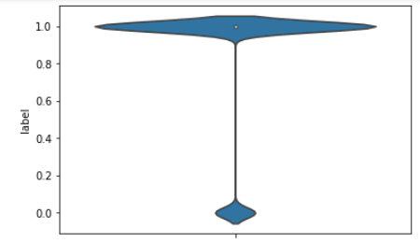
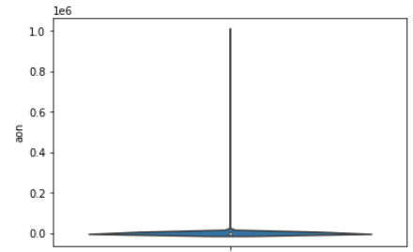
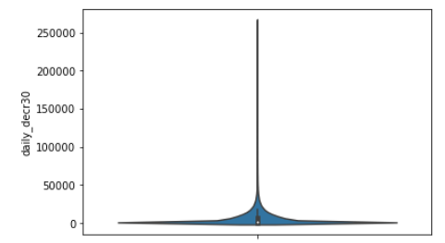
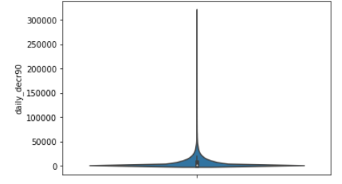
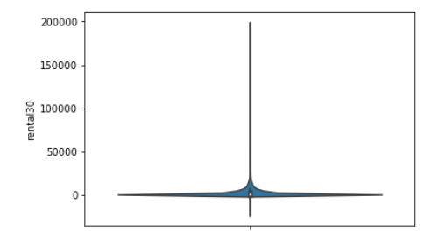
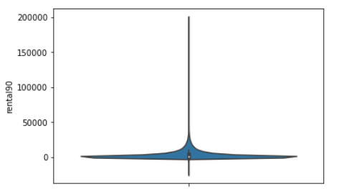
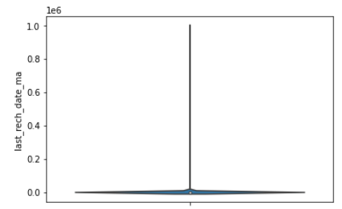
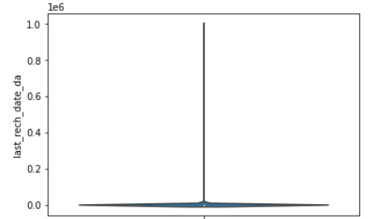
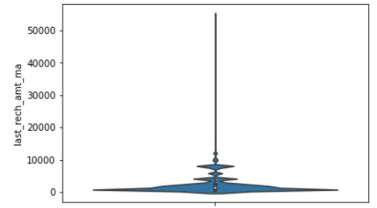
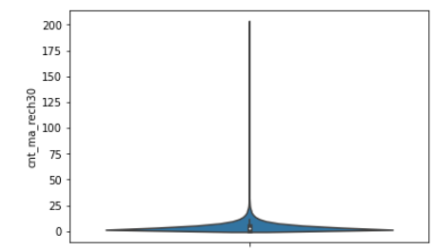
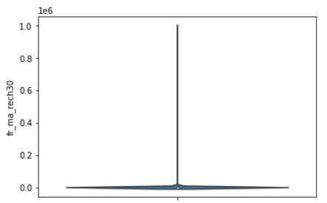
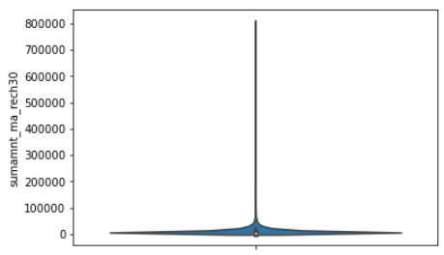
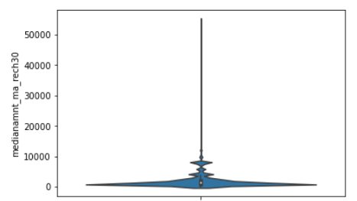
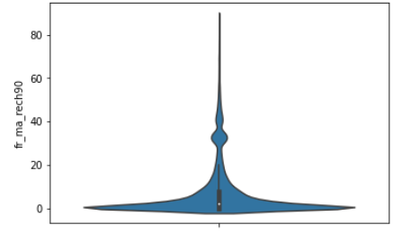
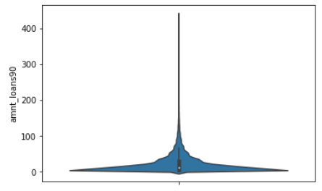
STEP 4
VISUALIZATIONS
-Violinplot to get an idea of range regarding distribution of data

Slide 11
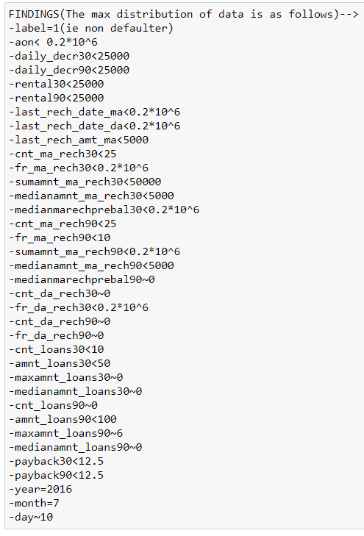

Slide 12
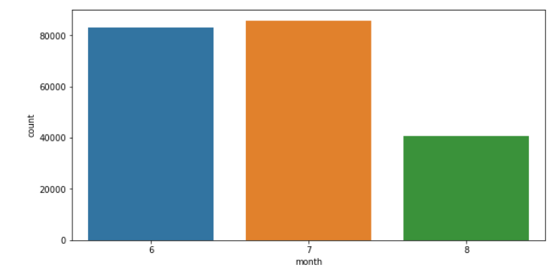
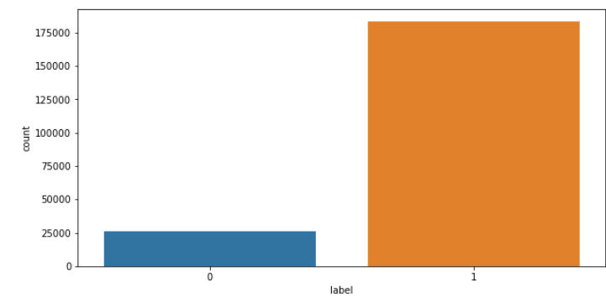
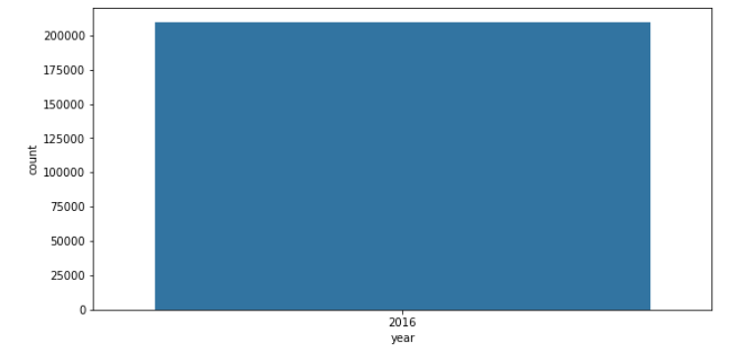
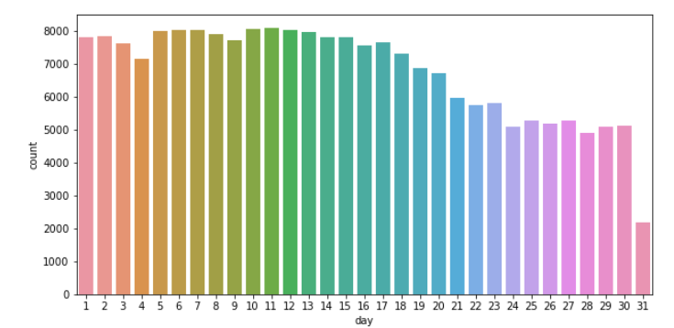
COUNTPLOT

Slide 13
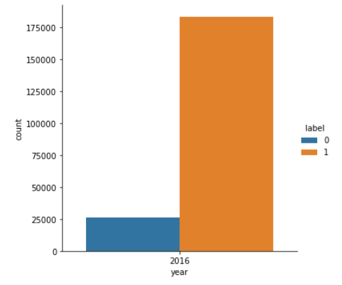
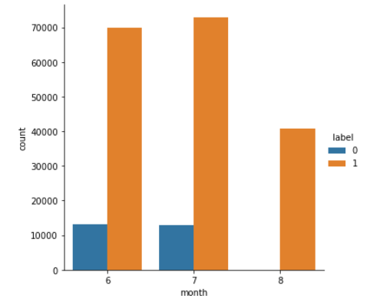
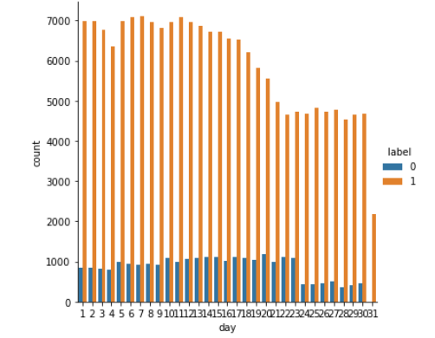
CATPLOT

Slide 14
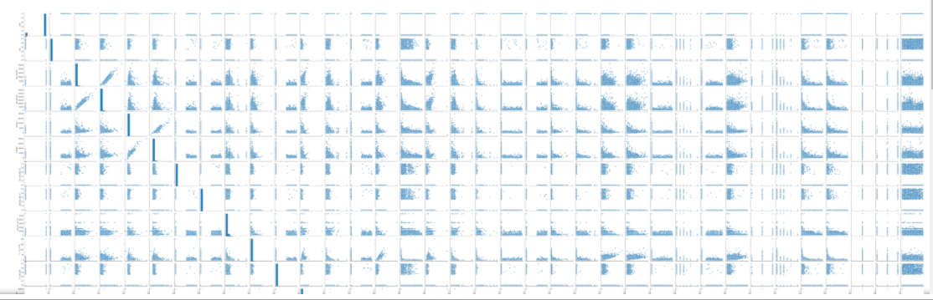
PAIRPLOT

Slide 15
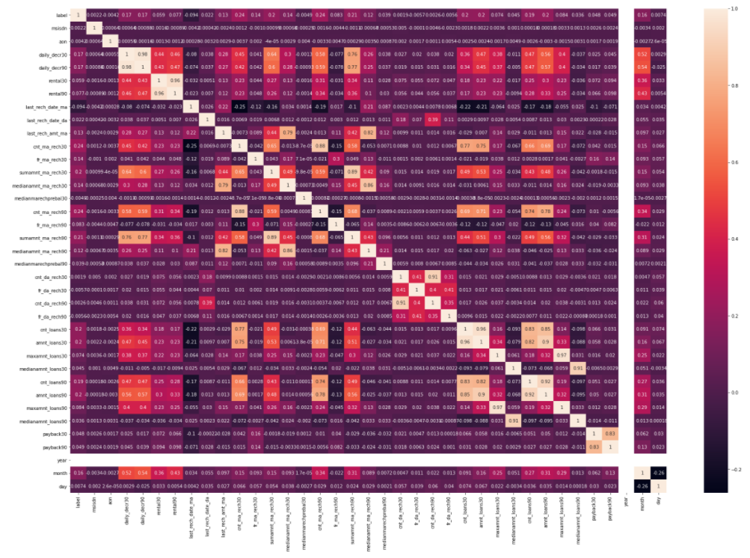
CORRELATION MATRIX

Slide 16
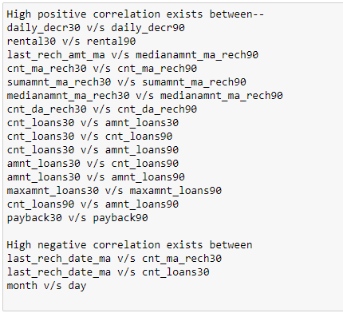
Using pairplot and correlation, we get the following results

Slide 17
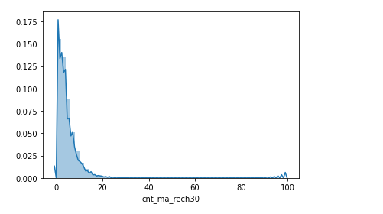
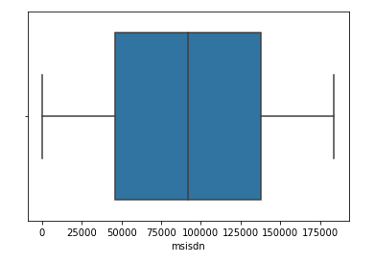
DISTPLOT for skewness
Example:
Boxplot
Example:

Slide 18
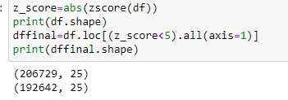
Thus, we treat the skewness and outliers

Slide 19
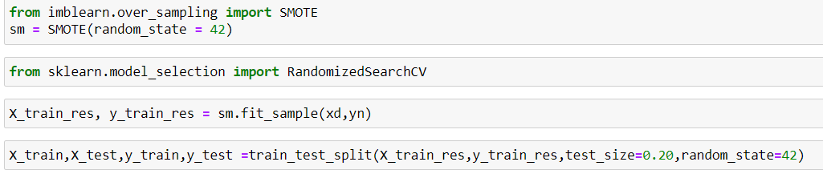
Step 5
Balancing the dataset

Slide 20
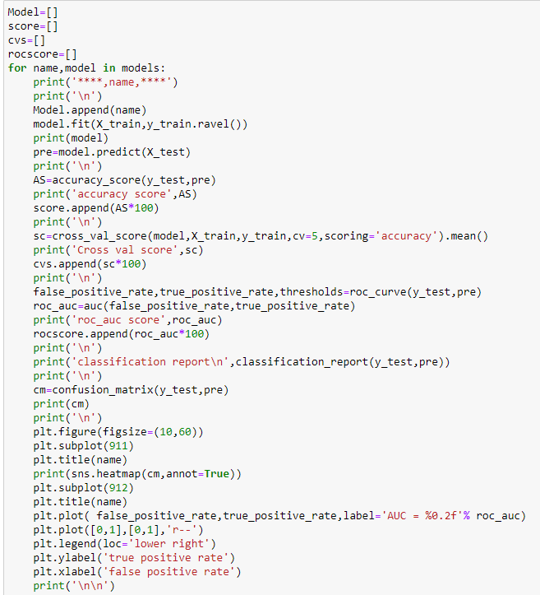
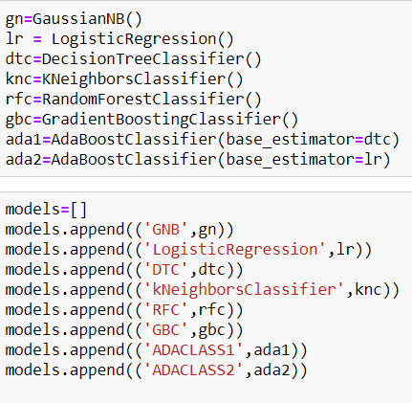
Step 6
Algorithms

Slide 21
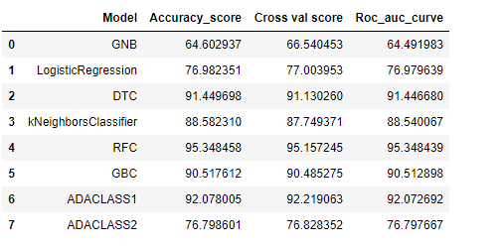
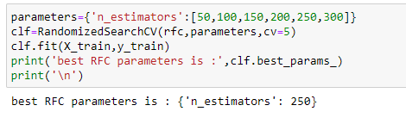


Step 7
Results and subsequent hypertune

Slide 22
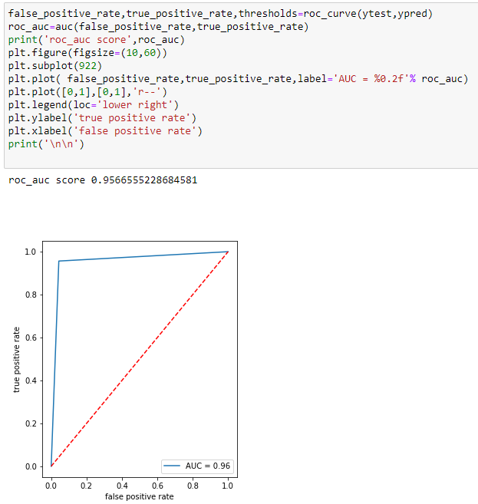
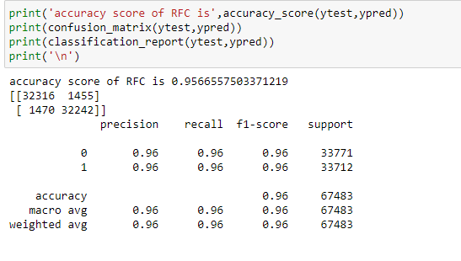
Step 8
Final model results

Slide 23
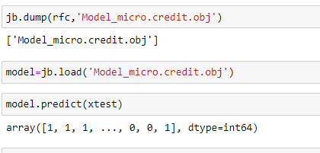
Final Step
SAVING THE MODEL AND TESTING

